Slide 1

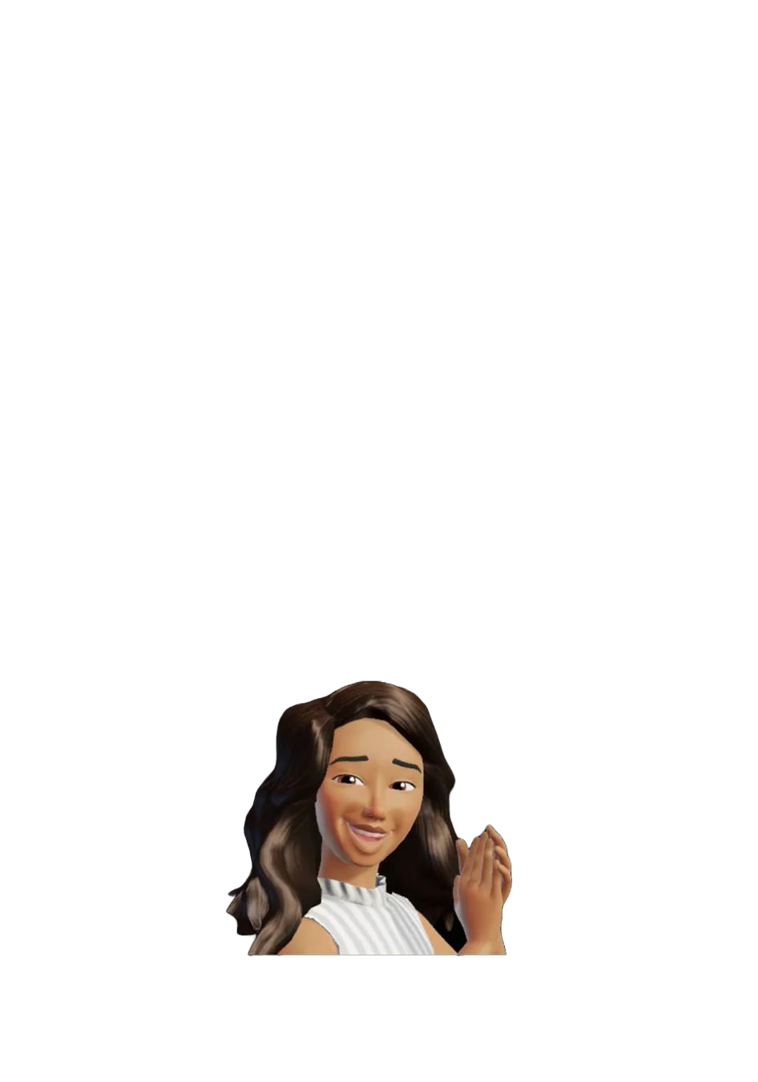

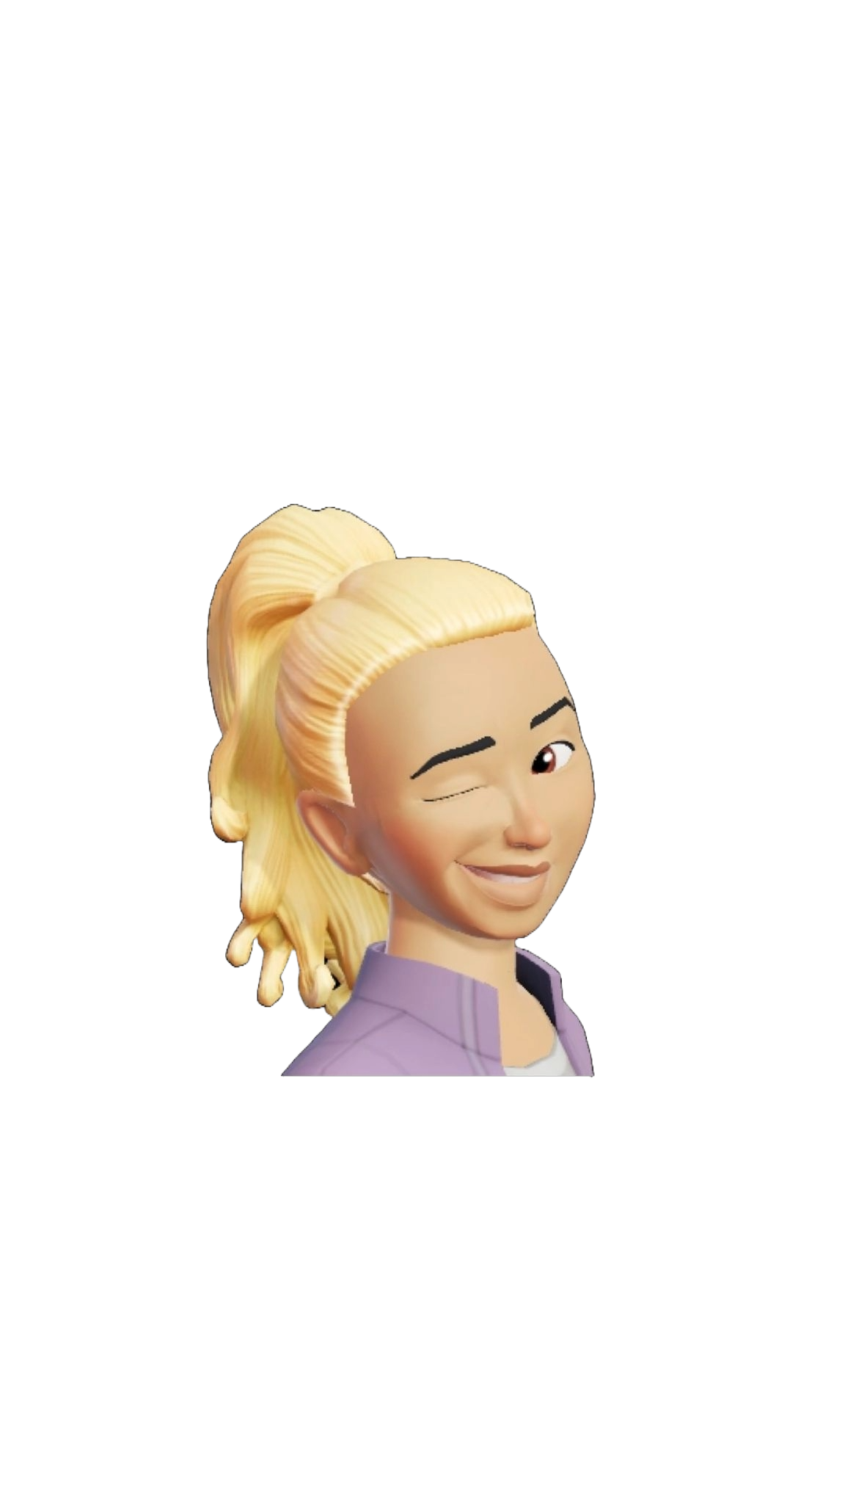
Solutions for team 31
First aim: transport of the Chimarrao kit;
Second aim: better cap for the cuia.
key feature: not bulky

Slide 2
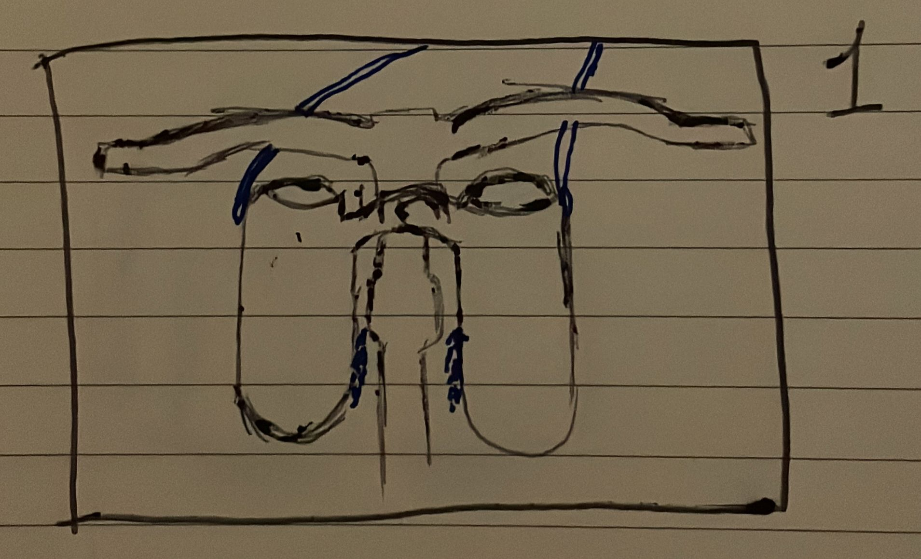
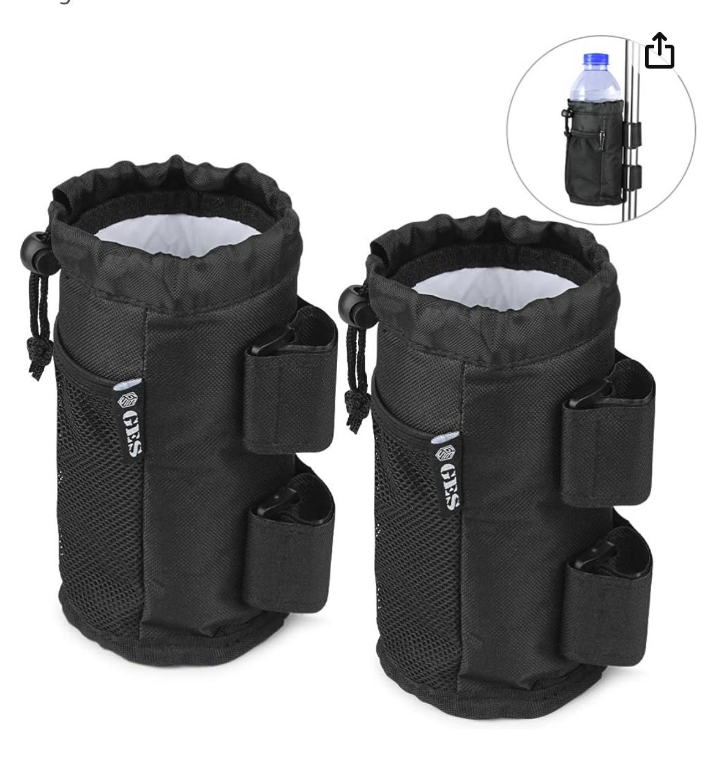
Solution 1 – Lovers bag
Two soft containers with a solid base linked by a bridge at the top and by straps at the bottom that attach them to the bike.
On the sides of the containers there are two hooks for the shoulder belt.
Inspiration: containers for
drinks with straps

Slide 3
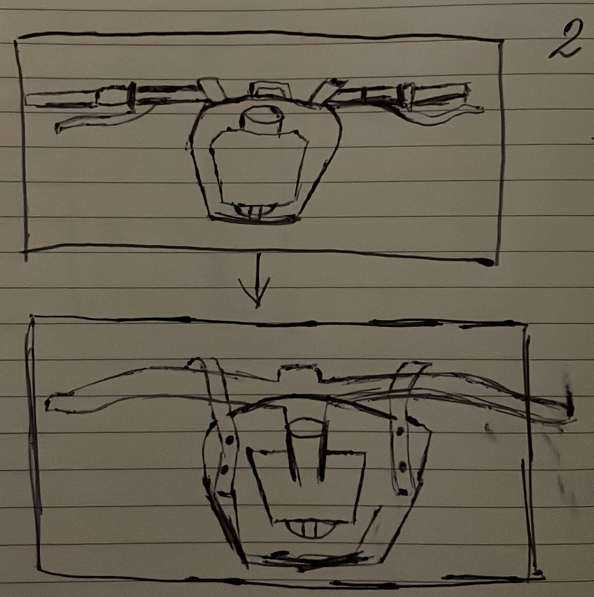
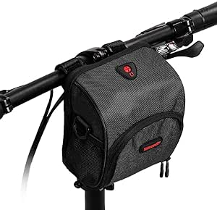
Solution 2 – Double face bag
A bike backpack with a front bag for the Termica and a rear bag for the Cuia.
Inspiration: a small bike backpack

Slide 4
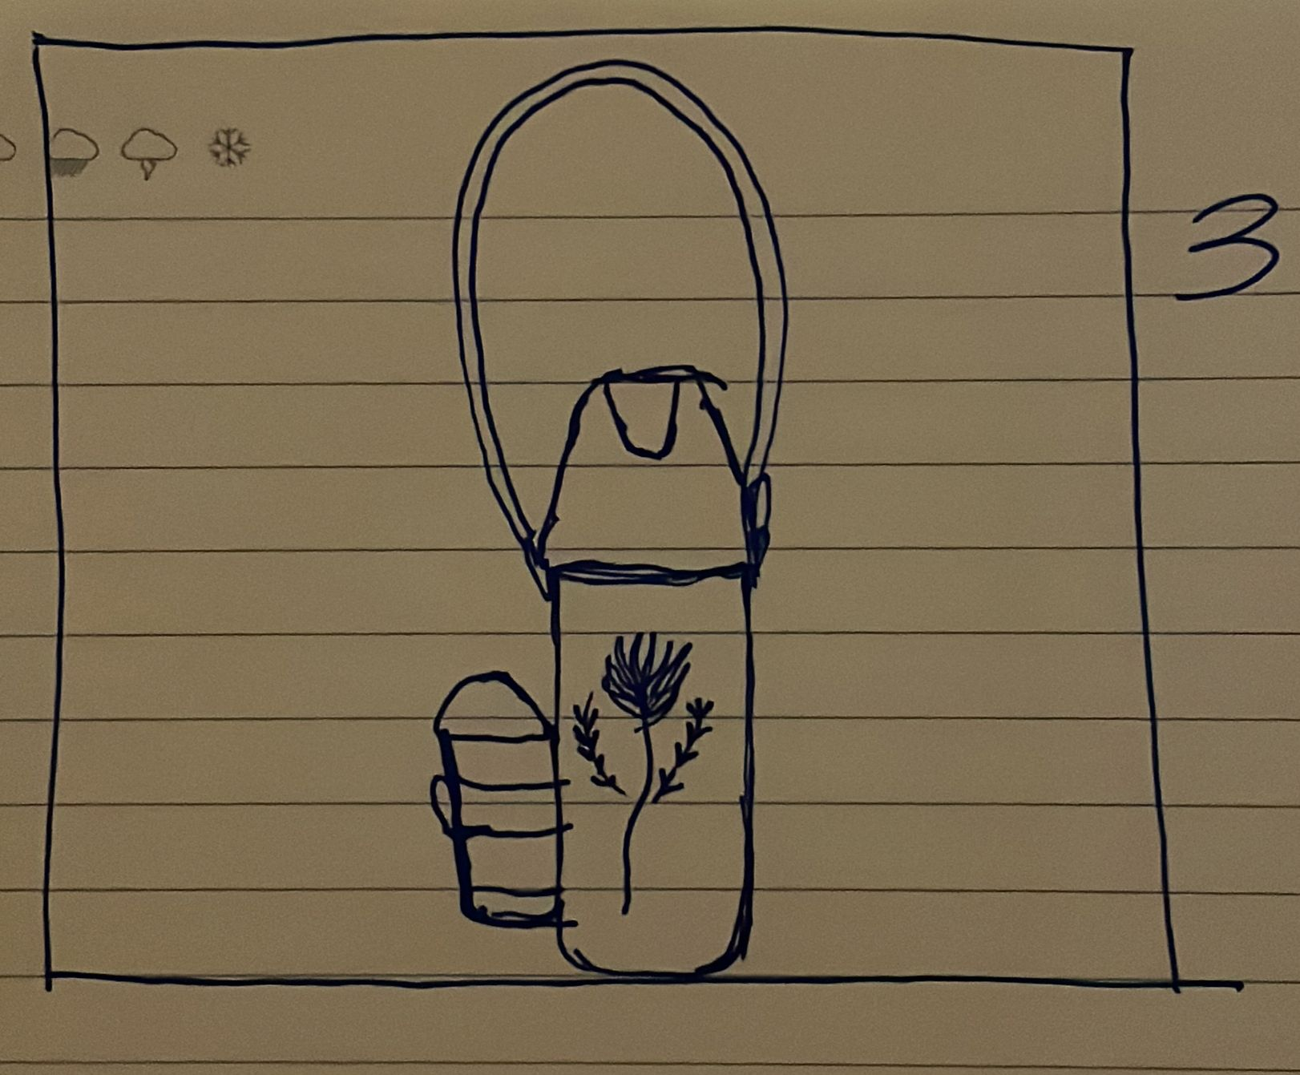
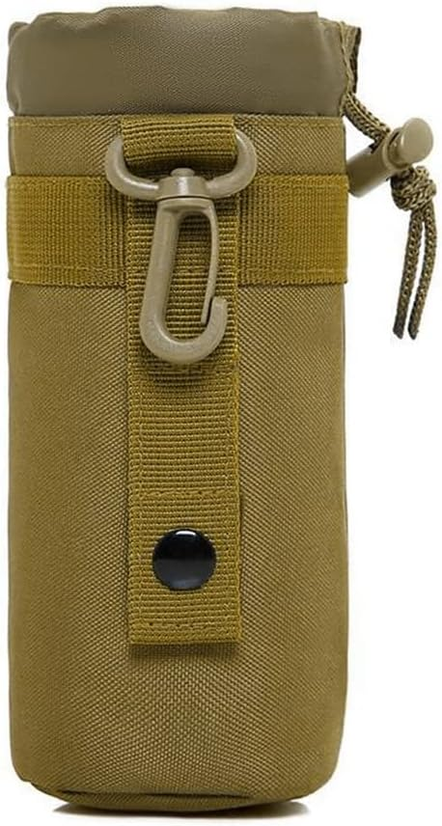
Solution 3 – Minimal bag with sidecuia
A Termica cover with adjustable shoulder belt and a side accessory tied to the cover to hold the Cuia.
Inspiration: bottle holder
with shoulder belt.

Slide 5
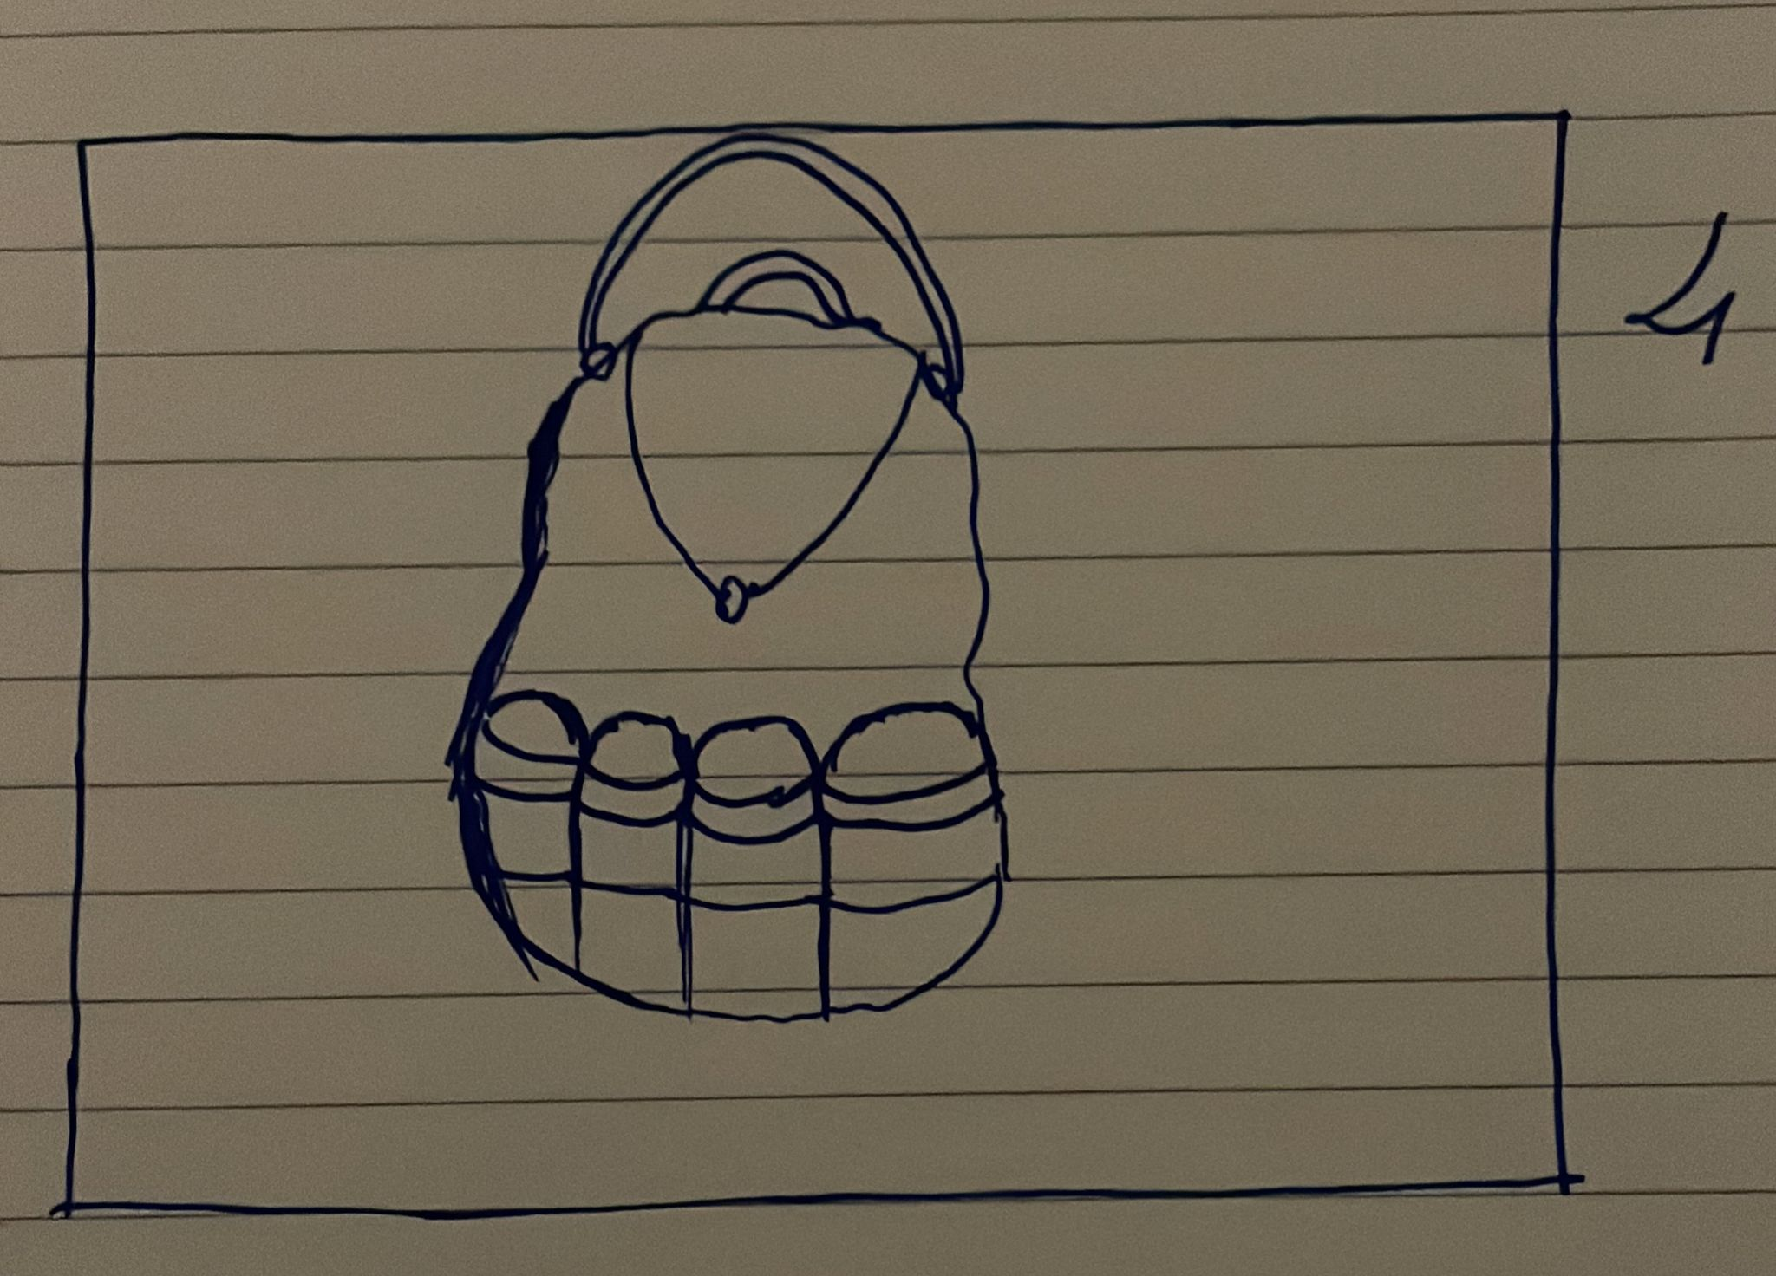
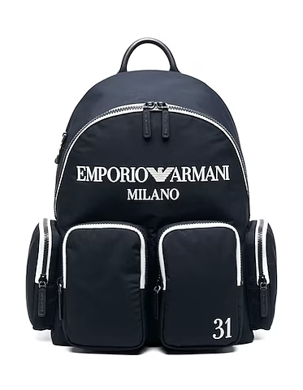
Solution 4 – Multitasking Chimarrao bag
A bag with numerous specific pockets for the whole Chimarrao kit.
It also has two adjustable shoulder belt.
Inspiration: A bag with a lot of pockets.

Slide 6
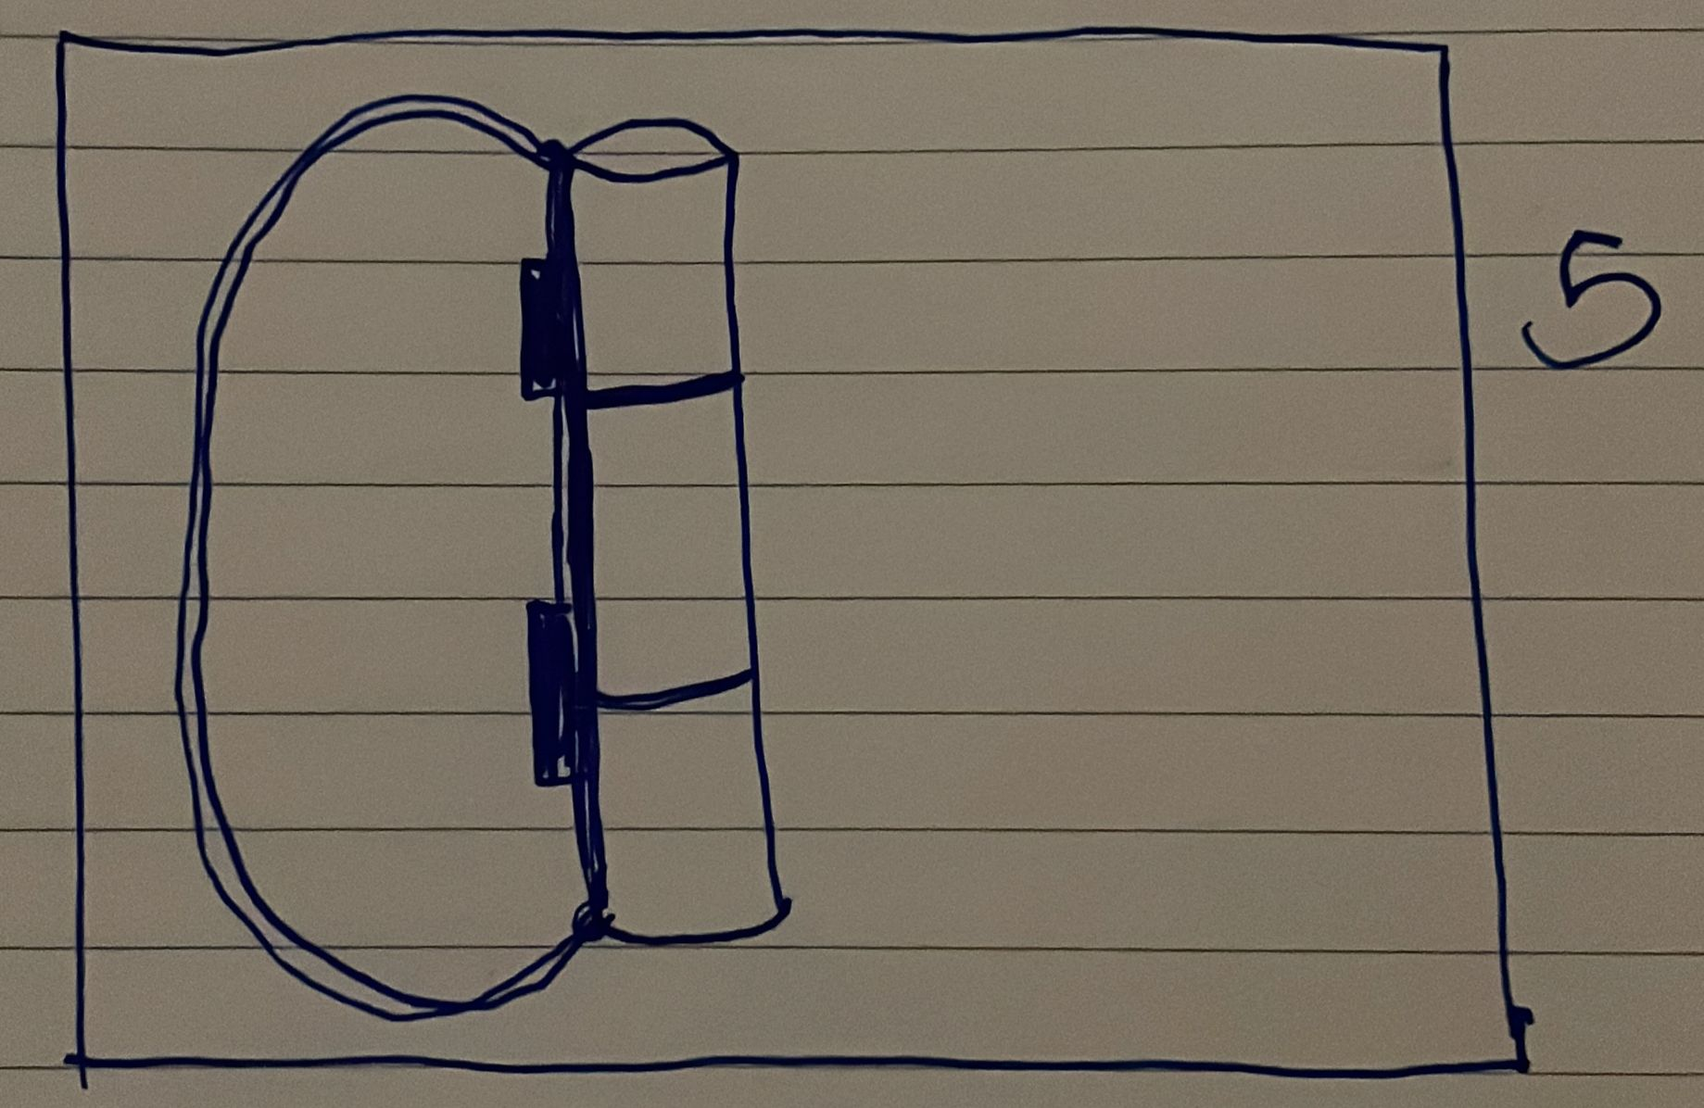
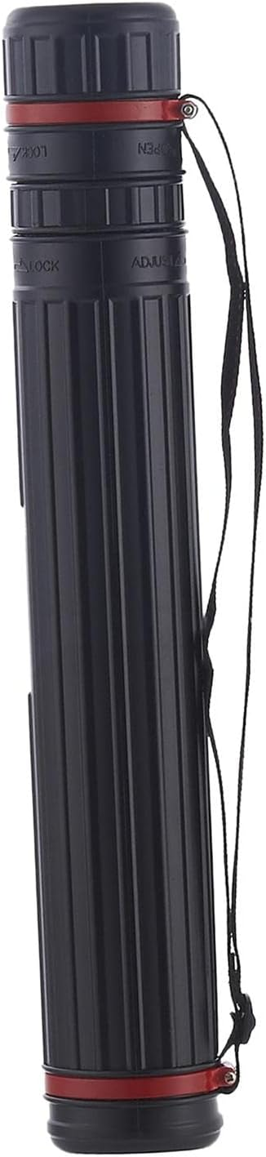
Solution 5 – Chimarrao’s stackable construction
A stackable container with three independent sections that open with a zip.
It has an adjustable shoulder belt and straps to attach it to the bike.
Inspiration: architect’s bag. Stackable bag with compartments.

Slide 7
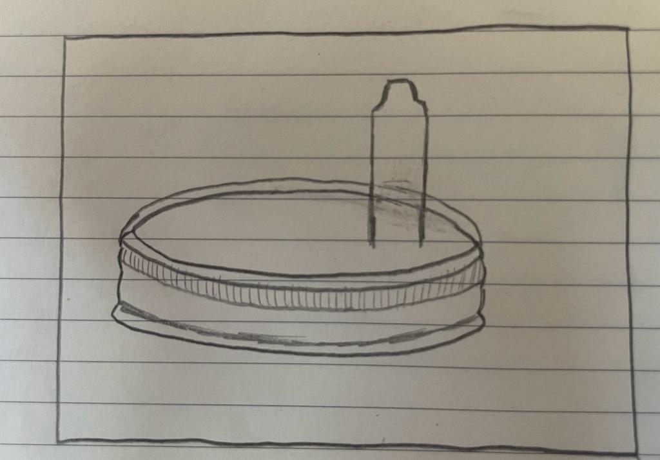
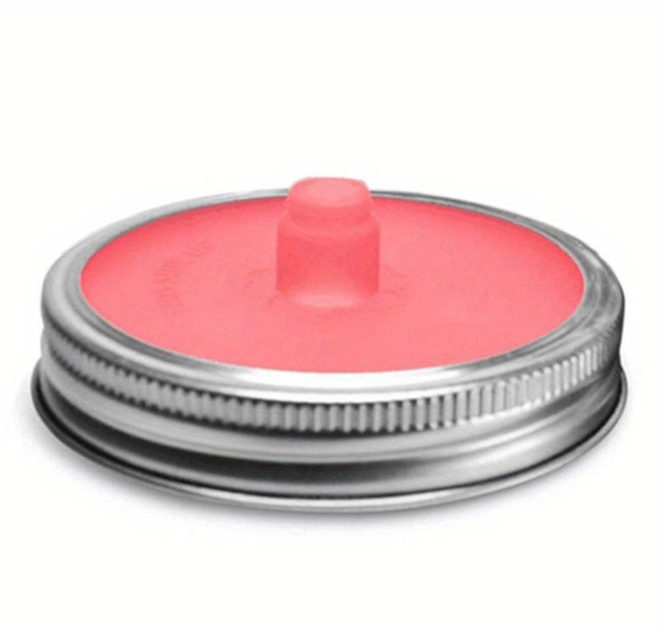
Second aim’s solution
All solutions will have this idea of hermetic cap with a cover for the Bomba (made by sustainable material).
Inspiration: hermetic cap

