Slide 1

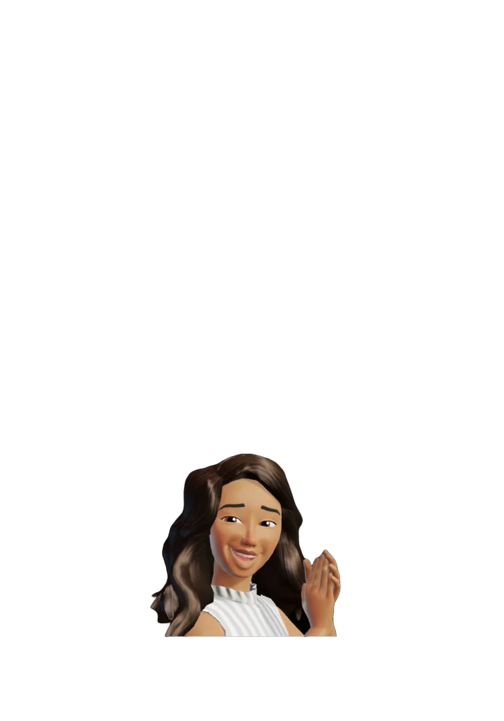

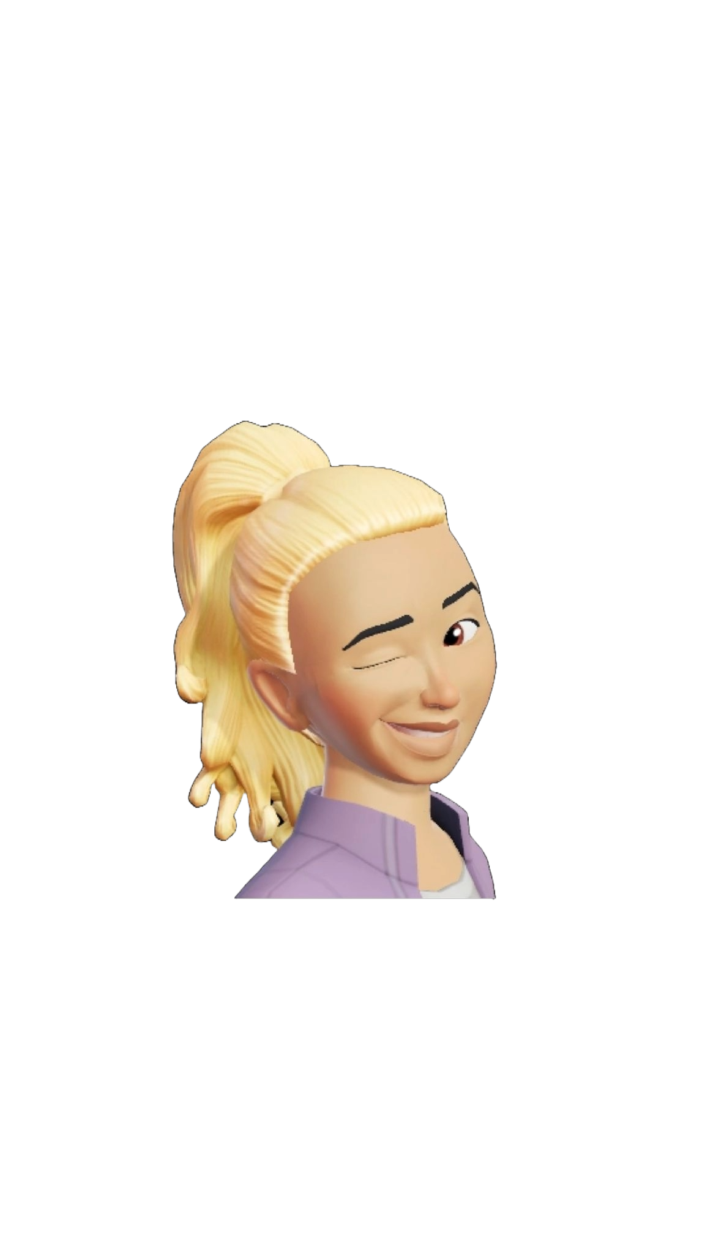
Solutions for team 31
First aim: transport of the Chimarrao kit;
Second aim: better cap for the cuia.
key feature: not bulky

Slide 2
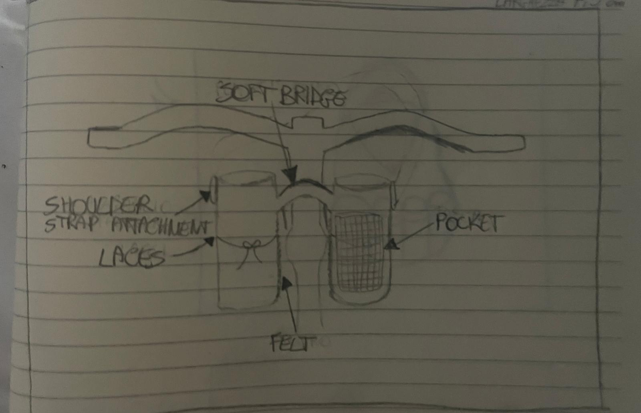
Solution 1 – Lovers bag
Two soft containers with a solid base linked by a bridge at the top and by straps at the bottom that attach them to the bike.
On the sides of the containers there are two hooks for the shoulder belt.
The container on the left is designed to contain the cuia, in fact it has a central lace that can be tightened to slow it down and prevent it from moving.
The right container is designed to hold your termal water bottle and it has an external pocket to hold personal items such as your cell phone or keys.
The felt is useful for keeping the two bags together with the bike.

Slide 3
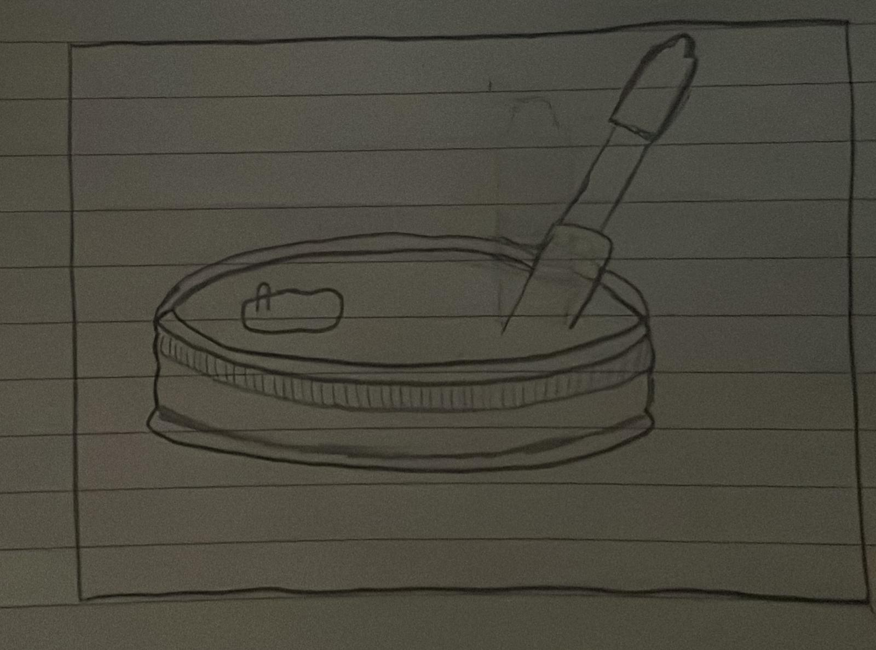
Second aim’s solution
All solutions will have this idea of hermetic cap with a cover for the Bomba.
This cap has a slot that opens and closes to put hot water.
The bomba has its own protection that can be put on and taken off.

